Slide 1
February 27, 2024
Leicester Public Schools
FY 2025 Budget Presentation
6:00PM
Leicester Town Hall

Slide 2
“Times They Are A-Changing”

Slide 3
Decreasing Student Population
LPS down 567 students over 25 years
Source: https://profiles.doe.mass.edu/

Slide 4
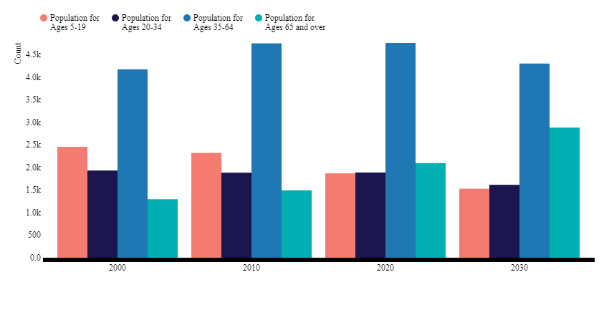
Changing Town Population
Source: http://www.housing.ma/leicester/report

Slide 5
Changing Demographics 1993 LPS
Source: MA DESE https://profiles.doe.mass.edu/

Slide 6
Changing Demographics 2024 LPS
Source: MA DESE https://profiles.doe.mass.edu/

Slide 7
2023 vs. 2024 comparison
Source: MA DESE https://profiles.doe.mass.edu/

Slide 8
Economic Disadvantaged 1993
Source: MA DESE https://profiles.doe.mass.edu/

Slide 9
Economic Disadvantaged 2024
Source: MA DESE https://profiles.doe.mass.edu/

Slide 10
English Language Learners
Source: MA DESE https://profiles.doe.mass.edu/

Slide 11
Takeaways
Less school aged students
Growing over 65 population
Changing demographics
Increased needs of students
Asked to do more with less $$$$
What do we do?

Slide 12
How do we attract students?
What are students looking for?
What are families looking for?
What can make LPS more competitive?

Slide 13
Career Technical Education
AV- no longer accepting LPS students.
50% acceptance rate at Tantasqua.
Limited opportunities for LPS students.
Demand for CTE greater than supply.

Slide 14
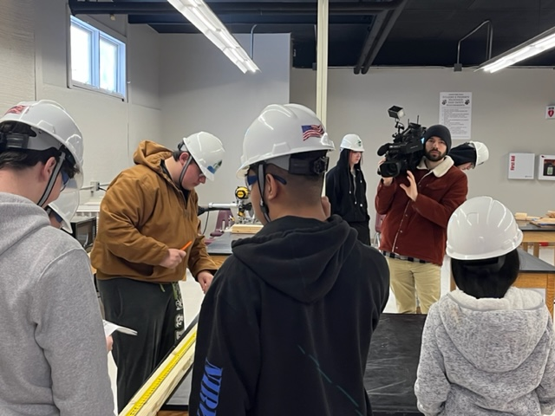
Building and Property Maintenance
1/18/24 Channel 5 visit
Students built potting benches to be donated to Senior Center

Slide 15
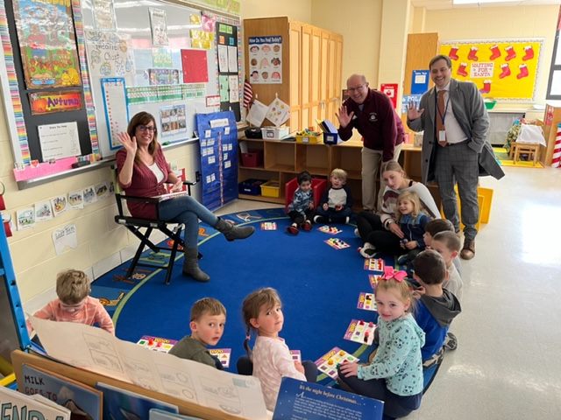
Early Education and Care
To date, LPS has two Chapter 74 approved programs:
Building and Property Maintenance
Early Education and Care

Slide 16
Chapter 74 Programs in process
Intent
To Apply Part A Part B
1. Culinary Arts Approved Approved March
2. Health Assisting Approved Approved March
3. Veterinary Science Approved Approved March
Once you have 5 Chapter 74 approved programs= exploratory

Slide 17
Culinary Arts (Ch. 74)
Students may graduate with:
Food Handler Certification
OSHA 10
ServSafe Manager Certification
Allergen Certification
Certified Fundamental Cooks
Career Opportunities:
Prep Cook, Line Cook, Bus Person
Bakery’s Assistant, Waiter/waitress, Dietary aid,
Banquet Server, Cake Designer

Slide 18
Health Assisting (Ch. 74)
Students may graduate with:
Basic Life Support (BLS)American Heart Association
Certified Nursing Assistant/ Home Health Aide
Alzheimer’s and Dementia Habilitation Training
OSHA 10
Career Opportunities:
Certified Nurse Aide, Home Health Aide, Patient Care
Technician, EMT, Personal Care, Attendant, Dietary
Aide, Geriatric Aide, Direct Care Specialist

Slide 19
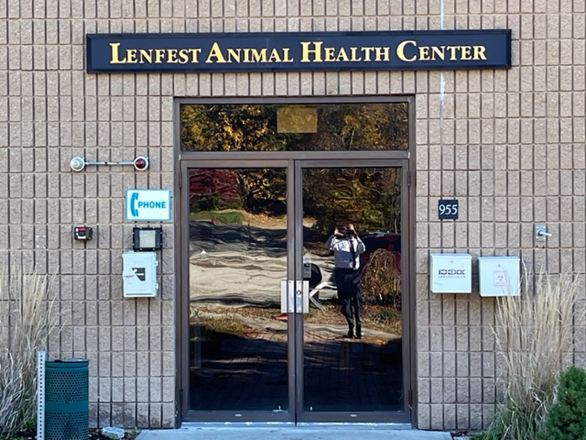
Veterinary Science (Ch. 74)
Concerns:
No partner to date
Application due 3/18
Costly
On hold for now and pick up part B next year.

Slide 20
CVTE TUITION COSTS
Description | FY20 Costs | FY21 Costs | FY22 Costs | FY23 Costs | FY24 Costs | FY25 Cost Projections | FY26 Cost Projections
Tuition Assabet & Tantasqua | $ 1,198,317 | $ 1,095,205 | $ 1,346,325 | $ 979,766 | $ 1,092,869 | $ 960,342 | $ 530,569
Transportation | $ 150,000 | $ 155,000 | $ 160,000 | $ 162,000 | $ 165,600 | $ 131,000 | $ 138,000
Total | $ 703,869 | $ 1,250,205 | $ 1,506,325 | $ 1,141,766 | $ 1,258,469 | $ 1,091,342 | $ 668,569

Slide 21
Innovation Pathways to date
Intent
To Apply Part A Part B
Business & Finance Approved Approved February
Advanced Manufacturing Started 2023-2024

Slide 22
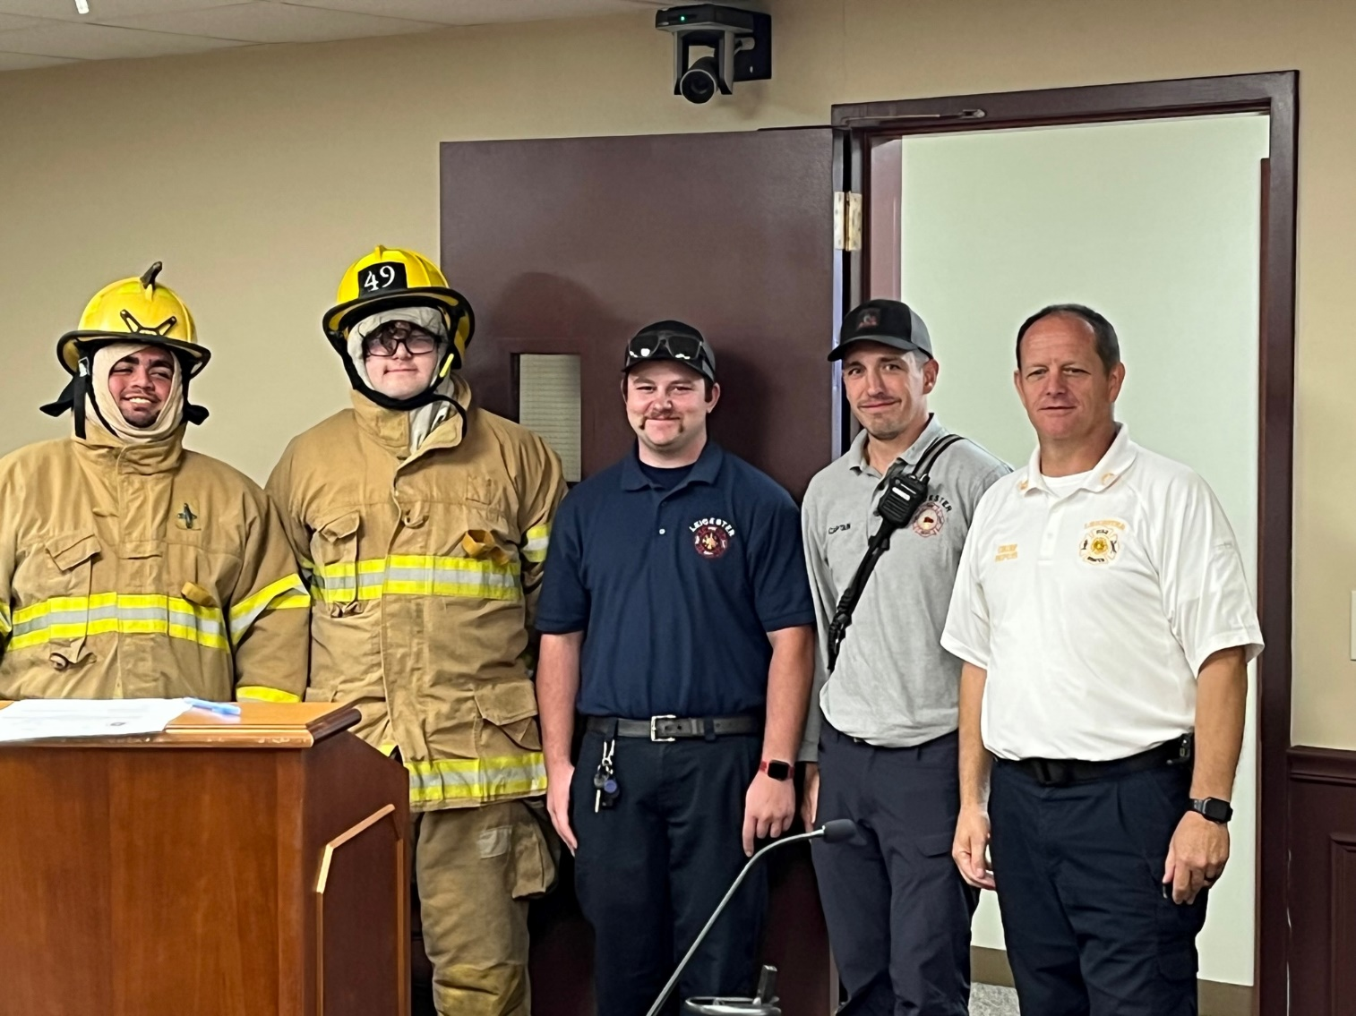
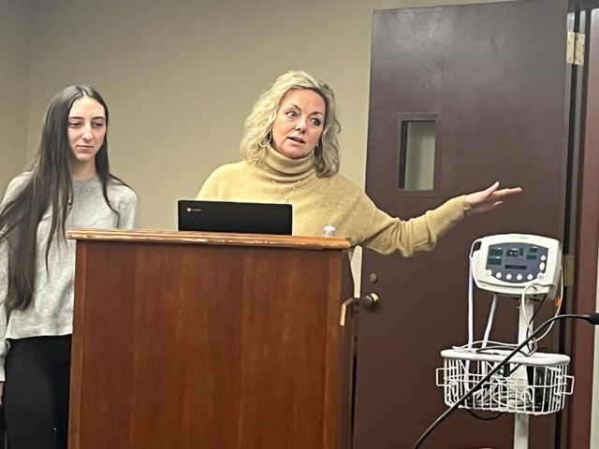
C.N.A. & Fire Science non ch. 74
LHS graduates need to be college and career ready.

Slide 23
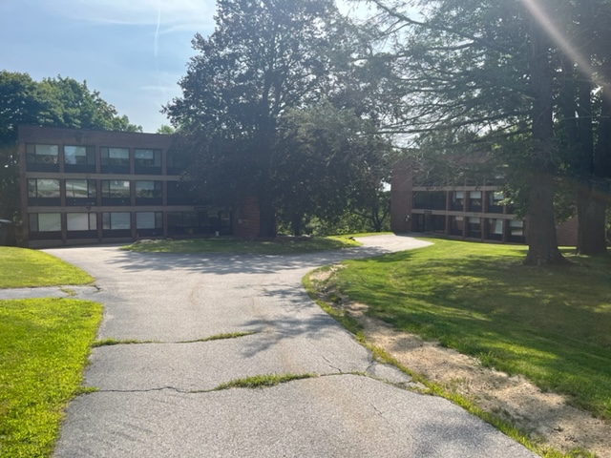
How has the CMHA impacted LPS?
All three buildings are at capacity
Barrett Hall (20 families)
Hampshire Hall (21 families)
Berkshire Hall (22 families)
https://www.cmhaonline.org

Slide 24
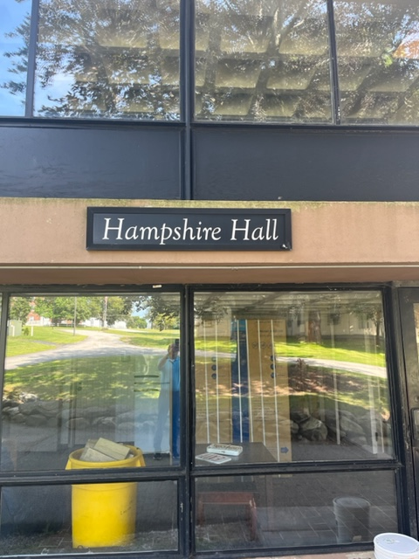
How has the CMHA impacted LPS?
To date, 17 students:
LES 7 students
LMS 4 students
LHS 6 students
Majority of children are 0-3 years old.
Other costs include: transportation, special education, ELL etc.
https://www.cmhaonline.org

Slide 25
FY 2025 Budget Update

Slide 26
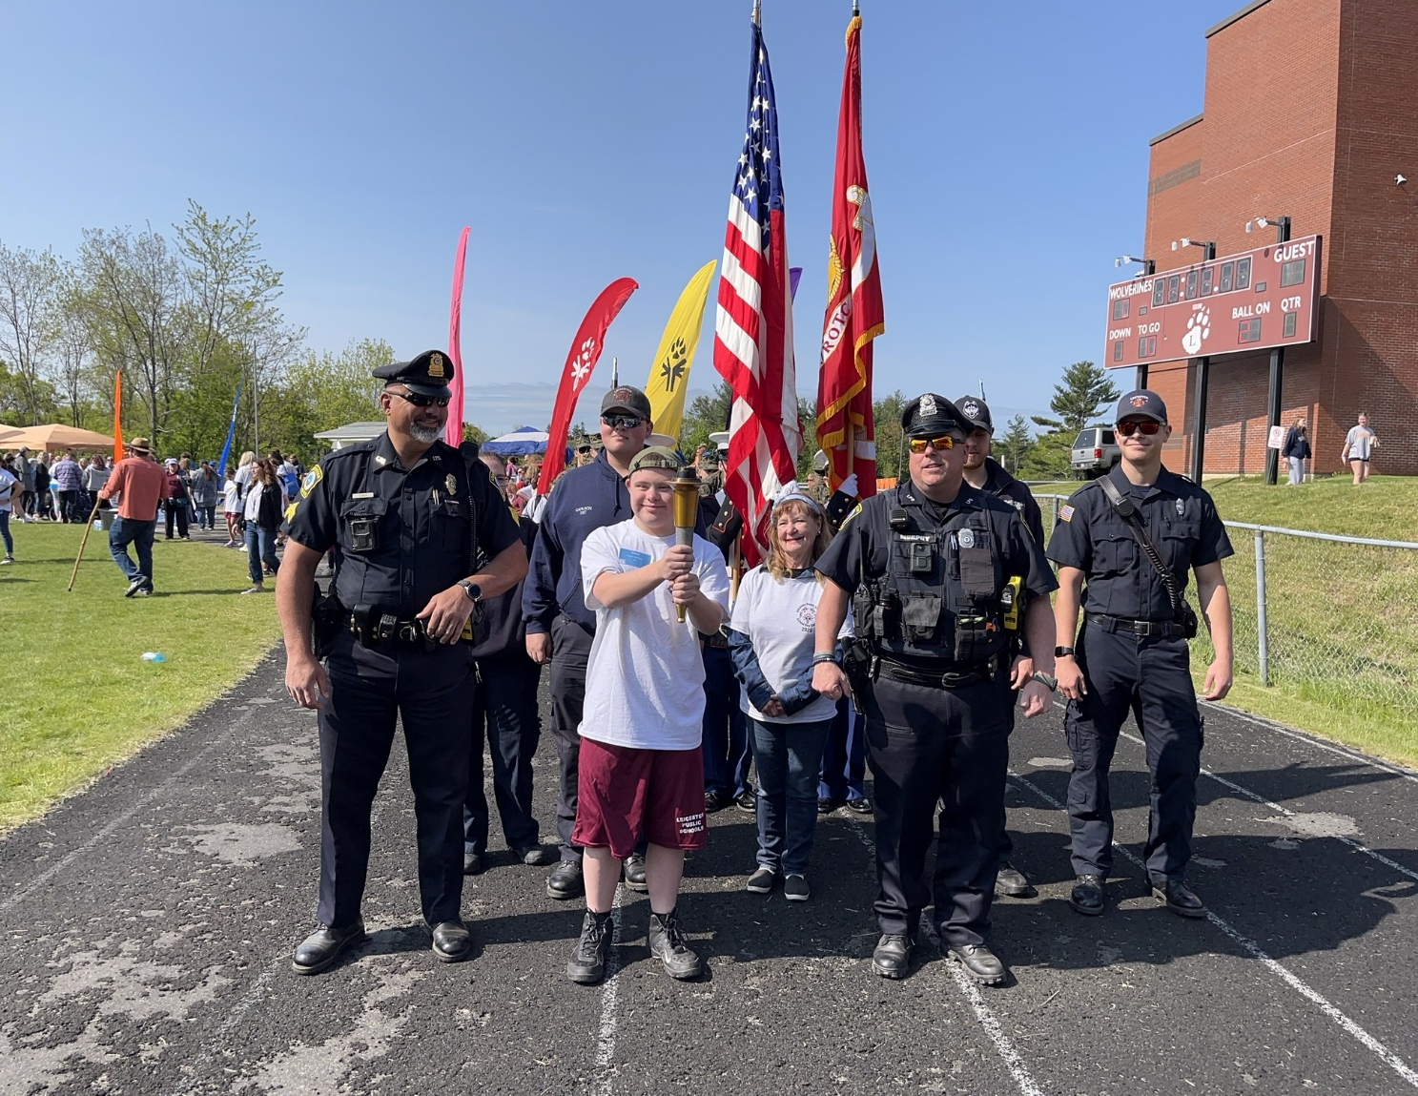
FY2025 Budget ~ Zero Based Budget
Staffing 18-22 program based on need 1 teacher and 1 para.
Chapter 74 teachers (2)- Health Assisting & Culinary.
Continued full time SRO & school safety campus monitors.

Slide 27
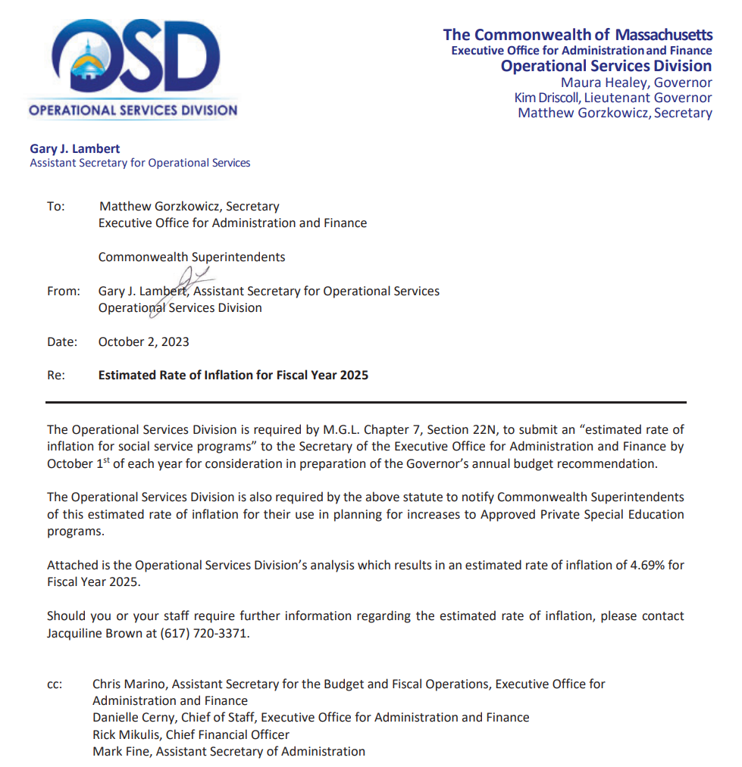
Out of District SPED
FY'15 | 1.53%
FY'16 | 1.40%
FY'17 | 1.83%
FY'18 | 1.15%
FY'19 | 2.33%
FY'20 | 1.63%
FY'21 | 2.72%
FY'22 | 2.26%
FY'23 | 2.54%
FY'24 | 14.00%
FY'25 | 4.69%

Slide 28
FY 2025 Budget
Special Education COSTS
EXPENSE CATEGORY | INCREASE AMOUNT FROM 2024
SPED TRANS IN DISTRICT PUBLIC | 213,630
HS SPED SALARIES TEACHER AIDES | 210,223
SPED-IN STATE PROGRAMS | 207,171
MIDDLES SPED SALARIES TEACHER AIDES | 202,731
ELE SPED TEACHER AIDES SALARIES | 166,550
MIDDLE SPED SALARIES TEACHERS | 162,953
SPED TRANS OOD PRIVATE | 102,714
SPED - CONTRACTED SERVICES | 89,907
 | 1,355,878
Many communities are dealing with same issue.

Slide 29
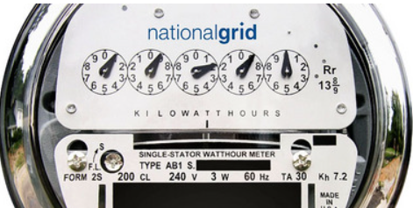
FY2025 Budget ~ $ 60,248
Increase in utility bills.
Utility bills continue to increase across the board
FY 2024 budget will be overspent
Still difficult to accurately predict

Slide 30
School Committee will vote budget 3/19
School Committee Recommended $22,086,109
Leicester Budget $20,630,236
Difference $ 1,455,873
Special Education Stabilization $ 681,604
School Choice offset $ 774,269
Total Additional Support $ 1,455,873

Slide 31
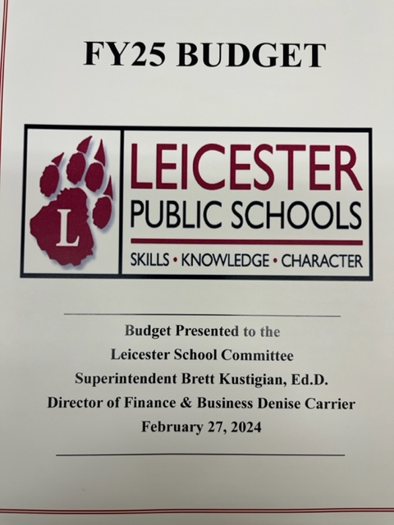
FY 2025 Budget Book
Questions
kustigianb@lpsma.net
carrierd@lpsma.net

Slide 32
FY 2025 Budget Timeline
Leicester
Massachusetts
Initial Budget Presented
February 27, 2024
Governor’s Budget
January 2024
Meet with SC, BFA, FAC
February 29, 2024
House Budget
April 2024
SC approves budget
March 19, 2024
Senate Budget
May 2024
Meet with stakeholders
Final Budget
June 30, 2024
Leicester
Town Mtg. May 7, 2023

Slide 33
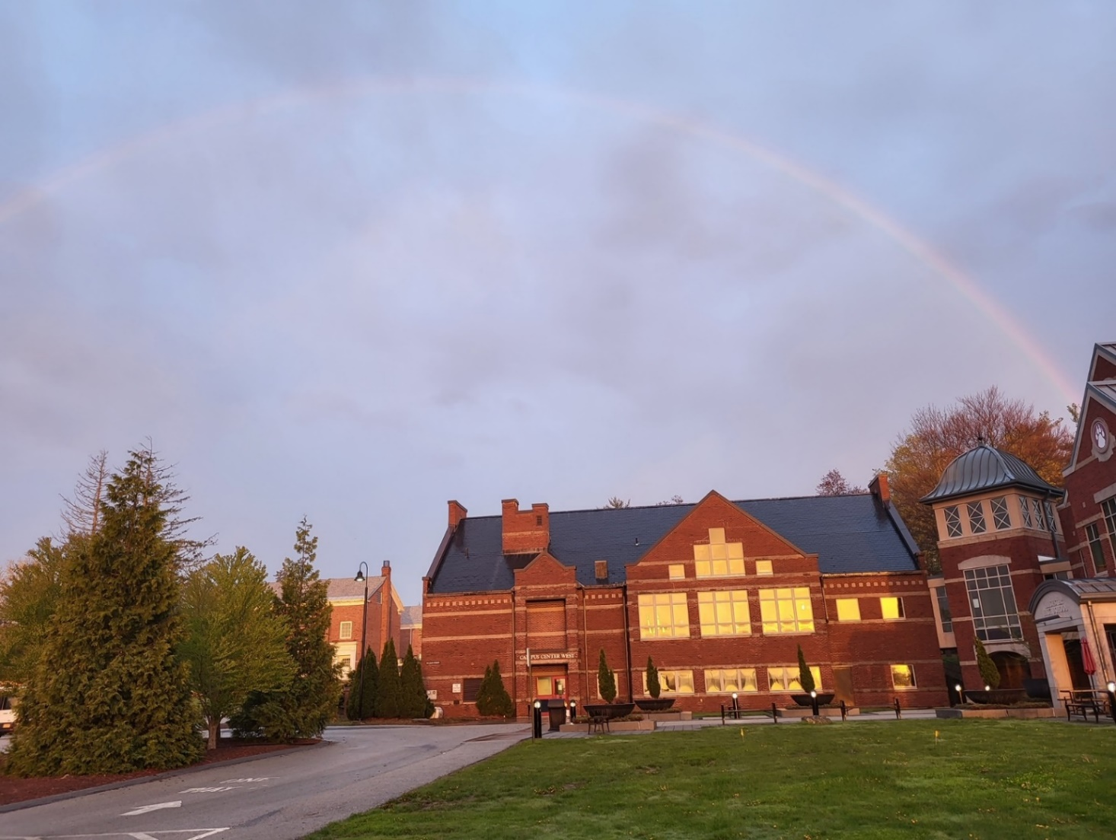
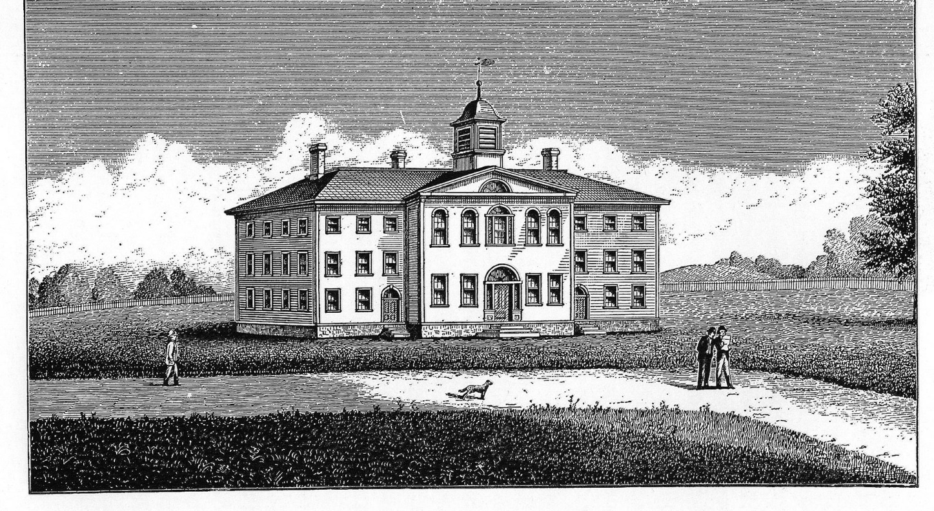
“The pot of gold is at the end of the rainbow, not the beginning.” -anonymous
Leicester Academy 1806
Leicester High School

